Slide 1
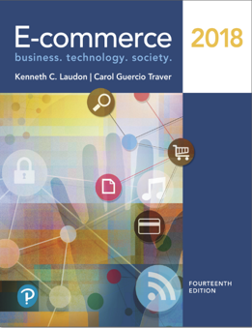
E-Commerce 2018: Business. Technology. Society
Fourteenth Edition
Chapter 6
E-commerce Marketing and Advertising Concepts
Copyright © 2019, 2018, 2017 Pearson Education, Inc. All Rights Reserved
Notes:
If this PowerPoint presentation contains mathematical equations, you may need to check that your computer has the following installed:
1) MathType Plugin
2) Math Player (free versions available)
3) NVDA Reader (free versions available)

Slide 2
Learning Objectives – Students presentations in 2 weeks
6.1 Understand the key features of the Internet audience, the basic concepts of consumer behavior and purchasing, and how consumers behave online.
6.2 Identify and describe the basic digital commerce marketing and advertising strategies and tools.
6.3 Identify and describe the main technologies that support online marketing.
6.4 Understand the costs and benefits of online marketing communications.
Notes:
Slide 2 is list of textbook LO numbers and statements

Slide 3
Video Ads: Shoot, Click, Buy
Class Discussion
What advantages do video ads have over traditional banner ads?
Where do sites such as YouTube fit in to a marketing strategy featuring video ads?
What are some of the challenges and risks of placing video ads online?
Do you think Internet users will ever develop “blindness” toward video ads as they have towards display ads?

Slide 4
Consumers Online: The Internet Audience and Consumer Behavior (1 of 3)
Over 75% (94 million) U.S. households have broadband Internet access in 2016
Growth rate has slowed
Intensity and scope of use both increasing
Some demographic groups have much higher percentages of online usage
Income, education, age, ethnic dimensions

Slide 5
Consumers Online: The Internet Audience and Consumer Behavior (2 of 3)
Broadband and mobile
Significant inequalities in broadband access
Older adults, lower income, lower educational levels
Non-broadband household still accesses Internet via mobile or other locations
Community effects
Role of social emulation in consumption decisions
“Connectedness”
Top 10–15% are more independent
Middle 50% share more purchase patterns of friends
Recommender systems - co-purchase networks

Slide 6
Consumers Online: The Internet Audience and Consumer Behavior (3 of 3)
Consumer behavior models
Study of consumer behavior; social science discipline
Attempt to predict or explain wide range of consumer decisions
Based on background demographic factors and other intervening, more immediate variables
Profiles of online consumers
Consumers shop online primarily for convenience

Slide 7
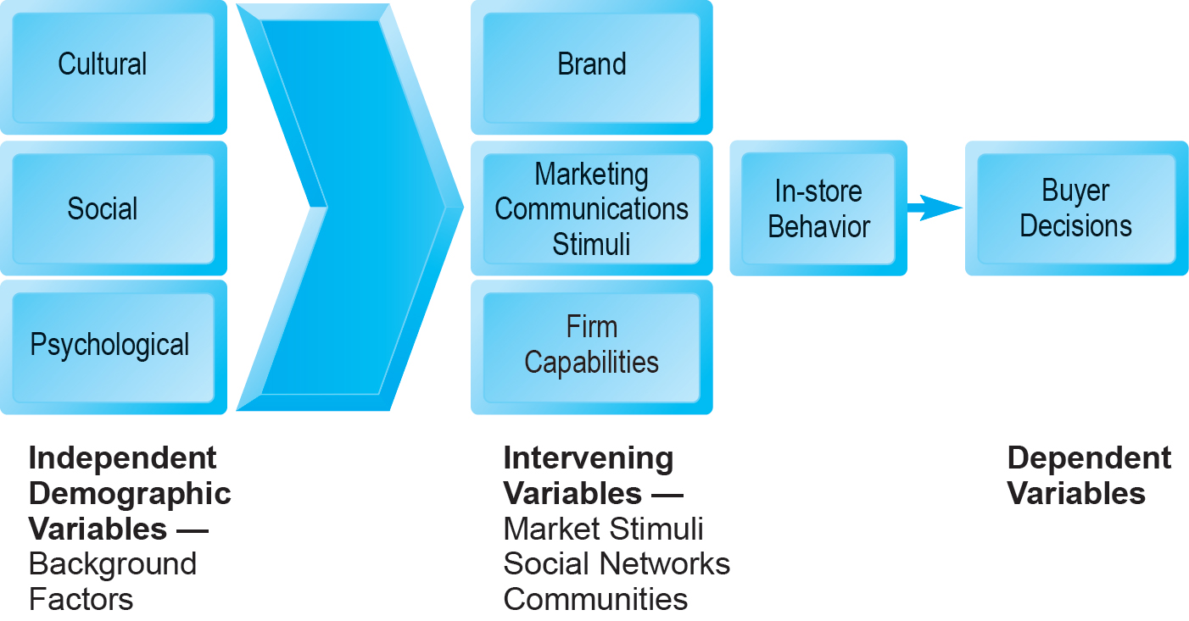
Figure 6.1 A General Model of Consumer Behavior
Notes:
Figure 6.1, Page 351.
Consumer behavior models try to predict the decisions that consumers make in the marketplace.
SOURCE: Adapted from Kotler and Armstrong, 2009.

Slide 8
The Online Purchasing Decision (1 of 2)
Five stages in consumer decision process
Awareness of need
Search for more information
Evaluation of alternatives
Actual purchase decision
Post-purchase contact with firm

Slide 9
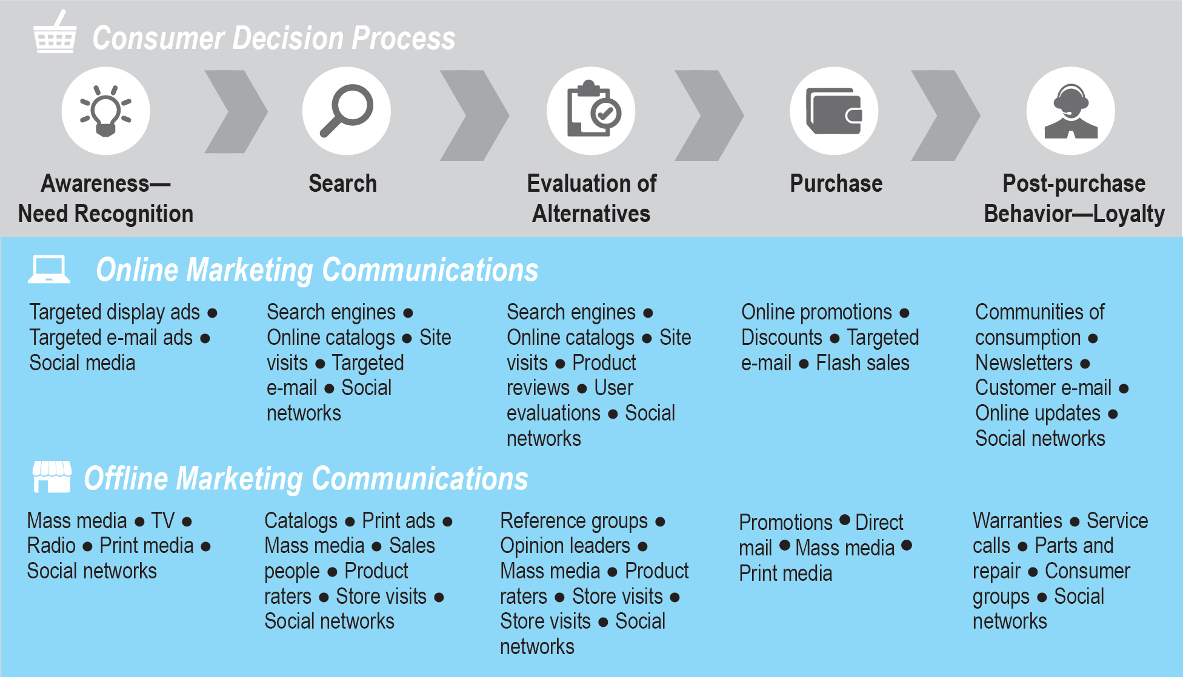
Figure 6.2 The Consumer Decision Process and Supporting Communications
Notes:
Figure 6.2, Page 352.

Slide 10
The Online Purchasing Decision (2 of 2)
Decision process similar for online and offline behavior
General online behavior model
User characteristics
Product characteristics
Website features: latency, usability, security
Attitudes toward online purchasing
Perceptions about control over Web environment
Clickstream behavior

Slide 11
Clickstream behavior
Clickstream behavior refers to the transaction log that consumers establish as they move about the Web, from search engine to a variety of sites, then to a single site, then to a single page, and then, finally, to a decision to purchase. These precious moments are similar to “point-of-purchase” moments in traditional retail. A

Slide 12
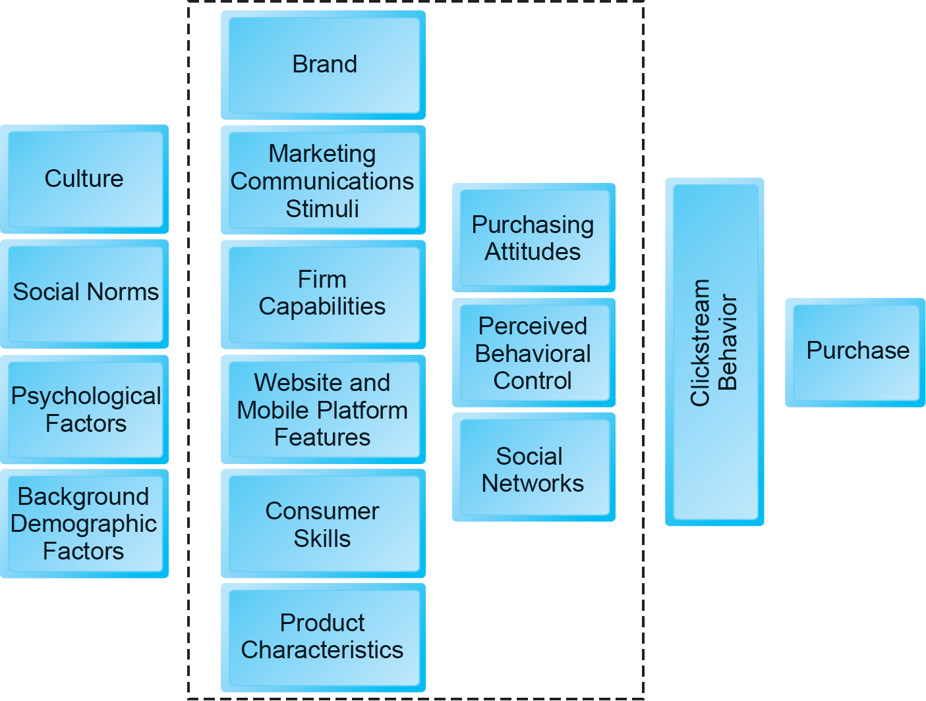
Figure 6.3 A Model of Online Consumer Behavior
Notes:
Figure 6.3, Page 353.
In this general model of online consumer behavior, the decision to purchase is shaped by background demographic factors, several intervening factors, and, finally, influenced greatly by clickstream behavior very near to the precise moment of purchase.

Slide 13
Shoppers: Browsers and Buyers
Shoppers: Over 90% of Internet users
Over 78% are buyers
13.2% are browsers (purchase offline)
Online research influenced over $2.1 trillion of retail purchases in 2016
Online traffic also influenced by offline brands and shopping
E-commerce and traditional commerce are coupled: Part of a continuum of consuming behavior

Slide 14
What Consumers Shop for and Buy Online
Big ticket items ($1000 or more)
Travel, computer hardware, electronics
Consumers now more confident in purchasing costlier items
Small ticket items ($100 or less)
Apparel, books, office supplies, software, etc.
Sales of bulky goods, furniture and large appliances, rapidly expanding

Slide 15
How Consumers Shop
How shoppers find online vendors
Highly intentional, goal-oriented
Search engines
Marketplaces (Amazon, eBay)
Specific retail site
About 8% of Internet users don’t shop online
Trust factor
Hassle factors (shipping costs, returns, etc.)

Slide 16
Trust, Utility, and Opportunism in Online Markets
Two most important factors shaping decision to purchase online:
Utility:
Better prices, convenience, speed
Trust:
Perception of credibility, ease of use, perceived risk
Sellers develop trust by building strong reputations for honesty, fairness, delivery

Slide 17
Digital Commerce Marketing and Advertising: Strategies and Tools
Features of Internet marketing (versus. traditional)
More personalized
More participatory
More peer-to-peer
More communal
The most effective Internet marketing has all four features

Slide 18
Multi-Channel Marketing Plan
Website
Traditional online marketing
Search engine, display, e-mail, affiliate
Social marketing
Social networks, blogs, video, game
Mobile marketing
Mobile/tablet sites, apps
Offline marketing
Television, radio, newspapers

Slide 19
Strategic Issues and Questions
Which part of the marketing plan should you focus on first?
How do you integrate the different platforms for a coherent message?
How do you allocate resources?
How do you measure and compare metrics from different platforms?
How do you link each to sales revenues?

Slide 20
Establishing the Customer Relationship
Website functions to:
Establish brand identity and customer expectations
Differentiating product
Anchor the brand online
Central point for all marketing messages
Inform and educate customer
Shape customer experience

Slide 21
Online Marketing and Advertising
Online advertising
Display, search, mobile messaging, sponsorships, classifieds, lead generation, e-mail
Advantages:
18–34 audience is online
Ad targeting to individuals
Price discrimination
Personalization

Slide 22
Traditional Online Marketing and Advertising Tools
Search engine marketing and advertising
Display ad marketing
E-mail marketing
Affiliate marketing
Viral marketing
Lead generation marketing

Slide 23
Search Engine Marketing and Advertising (1 of 2)
Search engine marketing (S E M)
Use of search engines for branding
Search engine advertising
Use of search engines to support direct sales
Types of search engine advertising
Paid inclusion
Pay-per-click (P P C) search ads
Keyword advertising
Network keyword advertising (context advertising)

Slide 24
Search Engine Marketing and Advertising (2 of 2)
Search engine optimization (S E O)
Google search engine algorithms
Social search
Utilizes social contacts and social graph to provide fewer and more relevant results
Search engine issues
Paid inclusion and placement practices
Link farms, content farms
Click fraud

Slide 25
Display Ad Marketing (1 of 2)
Banner ads
Rich media ads
Interstitial ads
Video ads
Far more effective than other display formats
Sponsorships
Native advertising

Slide 26
Display Ad Marketing (2 of 2)
Content marketing
Advertising networks
Ad exchanges, programmatic advertising, and real-time bidding (R T B)
Display advertising issues
Ad fraud
Viewability
Ad blocking

Slide 27
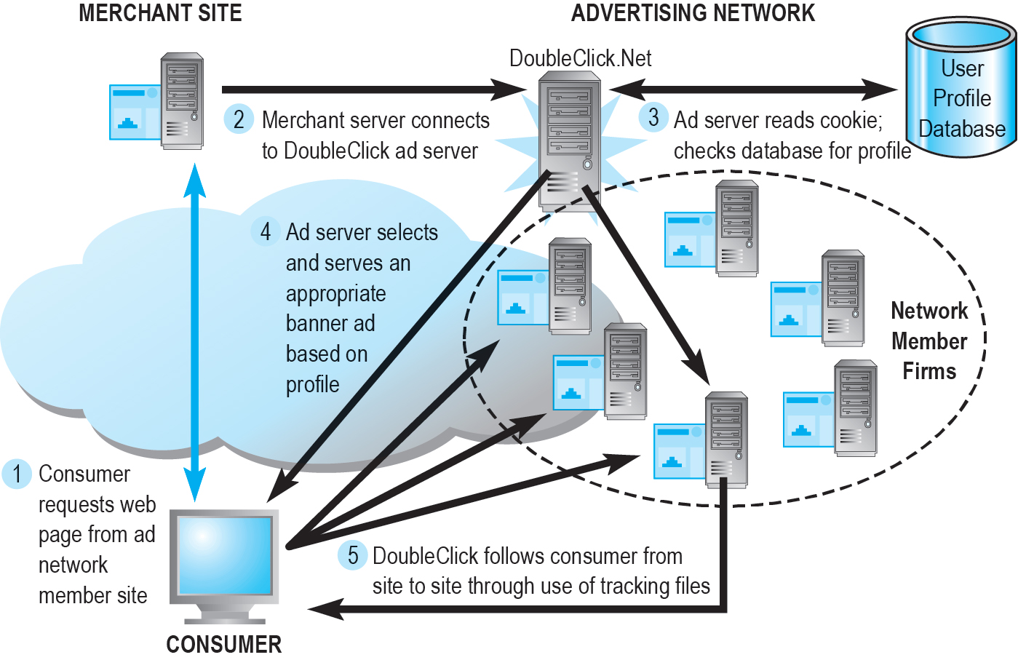
Figure 6.7 How an Advertising Network Such as Doubleclick Works
Notes:
Figure 6.7, Page 371.
Millions of publishers have audiences to sell, and pages to fill with ads. Thousands of advertisers are looking for audiences. Ad networks are intermediaries that connect publishers with marketers.

Slide 28
E-Mail Marketing
Direct e-mail marketing
Messages sent directly to interested users
Benefits include
Inexpensive
Average around 3% to 4% click-throughs
Measuring and tracking responses
Personalization and targeting
Three main challenges
Spam
Anti-spam software
Poorly targeted purchased e-mail lists

Slide 29
Spam
Unsolicited commercial e-mail
Around 55% of all e-mail in 2017
Most originates from bot networks
Efforts to control spam have largely failed:
Government regulation (C A N - S P A M)
State laws
Voluntary self-regulation by industries (D M A)
Canada’s stringent anti-spam laws

Slide 30
Other Types of Traditional Online Marketing
Affiliate marketing
Commission fee paid to other websites for sending customers to their website
Viral marketing
Marketing designed to inspire customers to pass message to others
Lead generation marketing
Services and tools for collecting, managing, and converting leads

Slide 31
Social, Mobile, and Local Marketing and Advertising
Social marketing and advertising
Use of online social networks and communities
Mobile marketing and advertising
Use of mobile platform
Influence of mobile apps
Local marketing
Geotargeting
Display ads in hyperlocal publications
Coupons

Slide 32
Multi-Channel Marketing
Integration of online and offline marketing
Increasing percentage of American media consumers use several media at once
Reinforce branding messages across media
Most effective multi-channel campaigns use consistent imagery across media

Slide 33
Insight on Business: Are the Very Rich Different from You and Me?
Class Discussion
What distinguishes luxury marketing from ordinary retail marketing?
What challenges do luxury retailers have in translating their brands and the look and feel of luxury shops into Web sites?
How has social media affected luxury marketing?
Visit the Net-a-Porter website. What do you find there?

Slide 34
Other Online Marketing Strategies
Customer retention strategies
One-to-one marketing (personalization)
Behavioral targeting (interest-based advertising)
Retargeting
Customization and customer co-production
Customer service
F A Qs
Real-time customer service chat systems
Automated response systems

Slide 35
Pricing Strategies (1 of 2)
Pricing: integral part of marketing strategy
Traditional pricing based on fixed costs, variable costs, demand curve
Marginal costs
Marginal revenue
Piggyback strategy
Price discrimination

Slide 36
Pricing Strategies (2 of 2)
Free and freemium
Versioning
Bundling
Dynamic pricing
Auctions
Yield management
Surge pricing
Flash marketing

Slide 37
Long Tail Marketing
Internet allows for sales of obscure products with little demand
Substantial revenue because
Near zero inventory costs
Little marketing costs
Search and recommendation engines

Slide 38
Insight on Technology: The Long Tail: Big Hits and Big Misses
Class Discussion
What are recommender systems? Give an example of one you have used.
What is the Long Tail and how do recommender systems support sales of items in the Long Tail?
How can human editors, including consumers, make recommender systems more helpful?

Slide 39
Internet Marketing Technologies
Internet’s main impacts on marketing:
Scope of marketing communications broadened
Richness of marketing communications increased
Information intensity of marketplace expanded
Always-on mobile environment expands marketing opportunities

Slide 40
Web Transaction Logs
Built into web server software
Record user activity at website
Provides much marketing data, especially combined with:
Registration forms
Shopping cart database
Answers questions such as:
What are major patterns of interest and purchase?
After home page, where do users go first? Second?

Slide 41
Cookies and Tracking Files
Types of tracking files
Cookies
Flash cookies
Web beacons (“bugs”)
Tracking headers (supercookies)
Other tracking methods
Deterministic cross-device tracking
Probabilistic cross-device tracking

Slide 42
Insight on Society: Every Move You Make, Every Click You Make, We’ll be Tracking You
Class Discussion
Are beacons innocuous? Or are they an invasion of personal privacy?
Do you think your web browsing should be known to marketers?
What are the Privacy Foundation guidelines for web beacons?
Should online shopping be allowed to be a private activity?

Slide 43
Databases
Enable profiling
Store records and attributes
Database management system (D B M S):
S Q L (Structured Query Language):
Industry-standard database query and manipulation language used in a relational database
Relational databases

Slide 44
Data Warehouses and Data Mining
Data warehouse:
Collects firm’s transactional and customer data in single location for offline analysis by marketers and site managers
Data mining:
Analytical techniques to find patterns in data, model behavior of customers, develop customer profiles
Query-driven data mining
Model-driven data mining
Rule-based data mining

Slide 45
Hadoop and the Challenge of Big Data
Big data
Petabyte, exabyte range
Web traffic, e-mail, social media, content
Traditional D B M S unable to process these Internet of Things
Hadoop
Open-source software framework
Processes any type of data, even unstructured
Distributed processing

Slide 46
Marketing Automation and Customer Relationship Management (C R M) Systems
Marketing automation systems
Track steps in lead generation
C R M systems
Manage relationship with customers once purchase is made
Create customer profiles
Customer data used to:
Develop and sell additional products
Identify profitable customers
Optimize service delivery, and so on

Slide 47
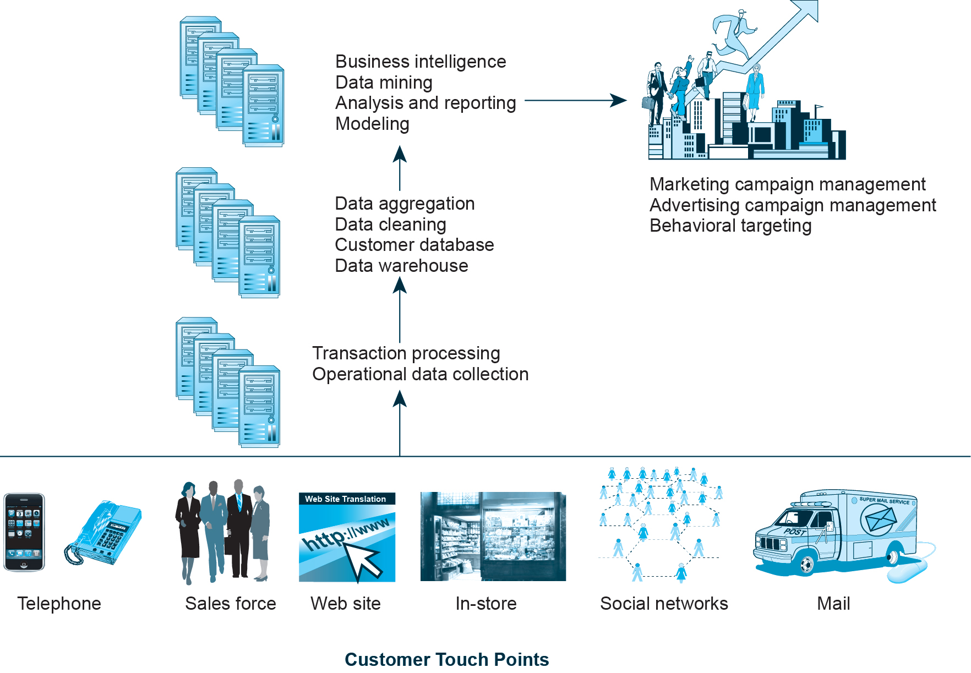
Figure 6.10 A Customer Relationship Management System
Notes:
Figure 6.10, Page 405.
This is an example of a CRM system. The system captures customer information from all customer touchpoints as well as other data sources, merges the data, and aggregates it into a single customer data repository or data warehouse where it can be used to provide better service, as well as to construct customer profiles for marketing purposes. Online analytical processing (OLAP) allows managers to dynamically analyze customer activities to spot trends or problems involving customers. Other analytical software programs analyze aggregate customer behavior to identify profitable and unprofitable customers as well as customer activities.

Slide 48
Online Marketing Metrics: Lexicon
Audience size/market share metrics
E.g. impressions, click-through rate (C T R), page views, viewability rate, stickiness, loyalty, reach, recency
Conversion to customer metrics
E.g. acquisition rate, conversion rate, browse-to-buy ratio, cart conversion rate, abandonment rate
Video ad metrics
E.g. view time, completion rate
E-mail campaign metrics
E.g. open rate, delivery rate, click-through rate, bounce-back rate

Slide 49
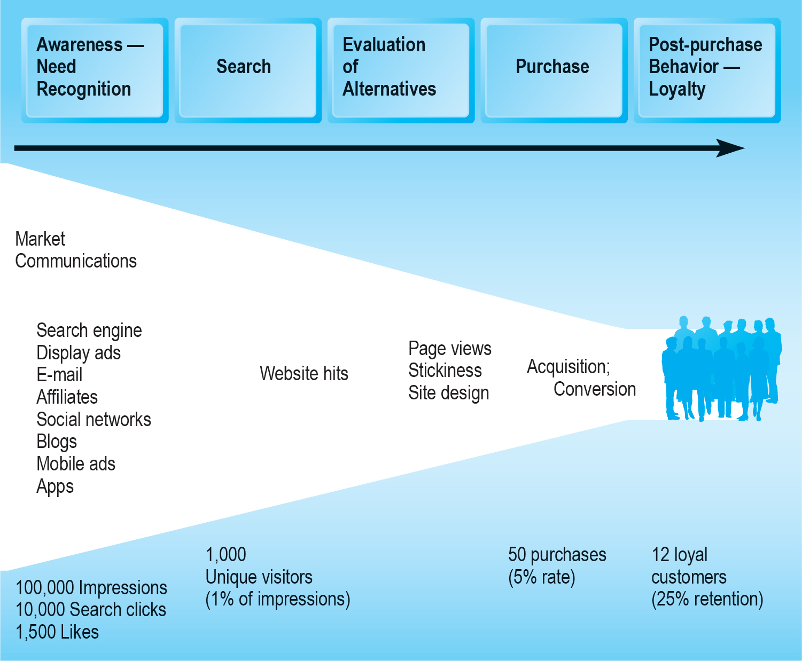
Figure 6.11 An Online Consumer Purchasing Model
Notes:
Figure 6.11, Page 410.
The conversion of visitors into customers, and then loyal customers, is a complex and long-term process that may take several months.

Slide 50
How Well Does Online Advertising Work?
Use R O I to measure ad campaign
Difficulty of cross-platform attribution
Highest click-through rates: Search engine ads, permission e-mail campaigns
Online channels compare favorably with traditional
Most powerful marketing campaigns use multiple channels, including online, catalog, T V, radio, newspapers, stores

Slide 51
The Costs of Online Advertising
Pricing models
Barter, cost per thousand (C P M), cost per click (C P C), cost per action (C P A), hybrid, sponsorship
Measuring issues
Correlating online marketing to online or offline sales
In general, online marketing is more expensive on C P M basis, but more efficient in producing sales
Effective cost-per-thousand (e C P M)

Slide 52
Marketing Analytics
Software that analyzes data at each stage of the customer conversion process
Awareness
Engagement
Interaction
Purchase activity
Loyalty and post-purchase
Helps managers
Optimize R O I on website and marketing efforts
Build detailed customer profiles
Measure impact of marketing campaigns

Slide 53
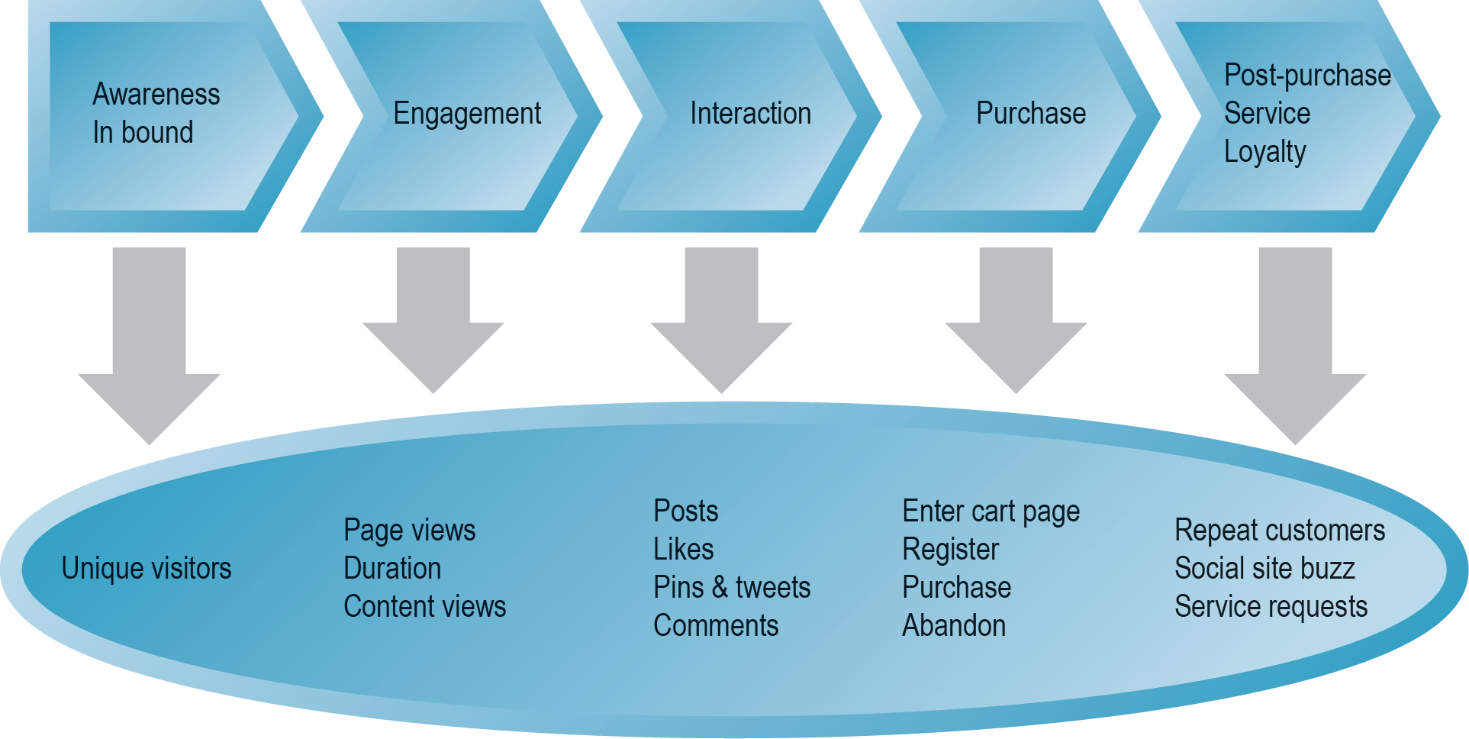
Figure 6.12 Web Analytics and the Online Purchasing Process
Notes:
Figure 6.12, Page 415.
Marketing analytics help e-commerce firms to better understand consumer behavior at each stage of the online purchasing process.

Slide 54
Careers in E - c o m m e r c e
Position: Digital Marketing Assistant
Qualification/Skills
Preparing for the Interview
Possible Interview Questions

Slide 55

Copyright

